Slide 1
Downstream Development Guideline

Slide 2
Version
Kafka 0.10.1

Slide 3
Brokers
Development :
10.95.108.206:9092 10.95.108.207:9092 10.95.108.208:9092
DR:
172.19.103.231:9092 172.19.103.232:9092 172.19.103.233:9092
Production:
IP: 10.81.5.101 port 9092 (IT nat:172.19.43.100) : mtg1-etgkafka-01
IP: 10.81.5.102 port 9092 (IT nat:172.19.43.101) :mtg1-etgkafka-02
IP: 10.81.5.103 port 9092 (IT nat: 172.19.43.102) :mtg1-etgkafka-03
in production, you need to map hostname. ถ้าไม่ทำการ Map จะไม่มีข้อมูลเข้า และไม่แสดง Error ใดๆ

Slide 4
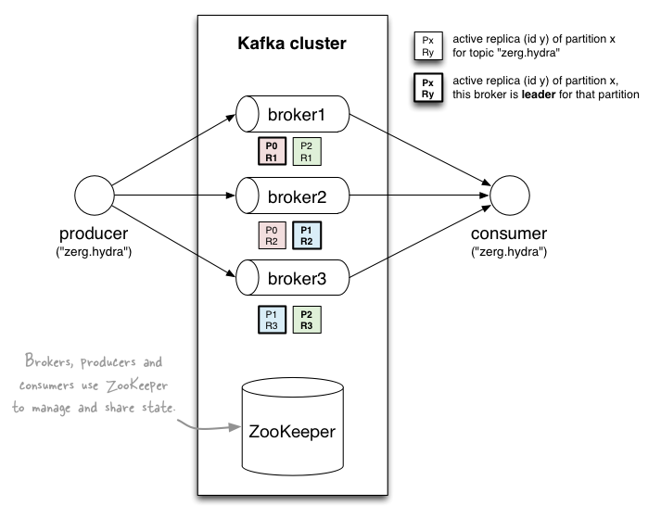
Brokers

Slide 5
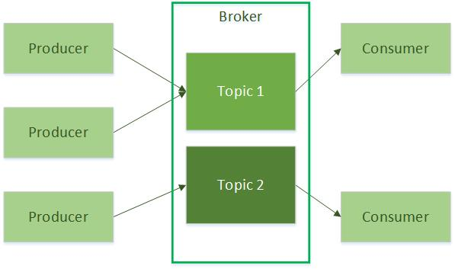
Topic
[source]-[event_id]
Example:
mldd-all,mldd-5200024
ccp-all,ccp-1400
am-all , am-93014
dmc-all,dmc-8111

Slide 6
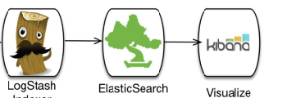
MLDD-Receiver
ETG
mldd-50041
MLDD
Json
MLDD Receiver
Producer
mldd-50042
mldd-all
.
.
.
.
etg-logs
MLDD-Event
Kafka stream
mldd-xxxx

Slide 7
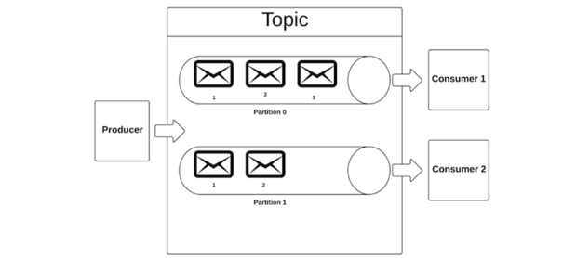
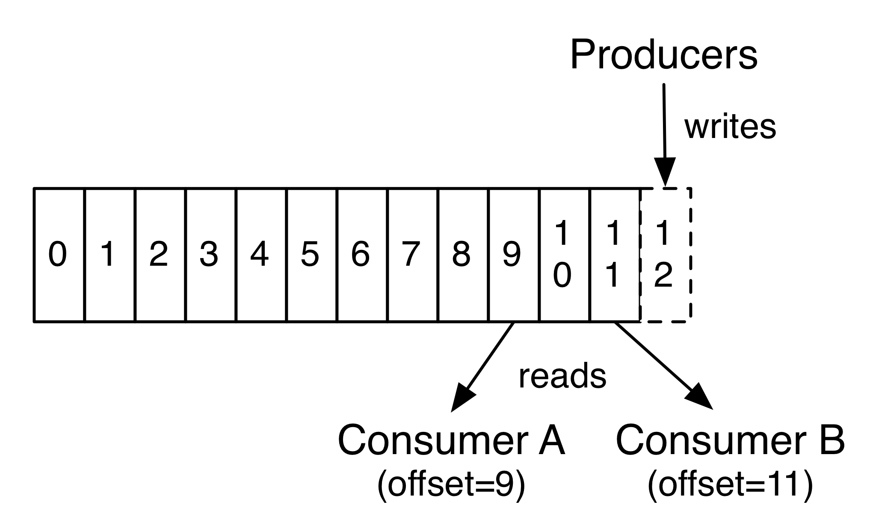
Connection & Partition
1 Topic contain 10 partitions
For max performance, create session up to 10 session per topic.
CustomerGroup must be consistent across thread.
consumerGroup1
Thread1
Thread2

Slide 8
Concern
Please confirm “consumerGroup” name to make sure your name is unique.
Data will store only 1 week. If consumer not get data within time. Data is lost.
Data hash by msisdn into partition id. Guarantee that data will be ordered in same partition.

Slide 9
Implement Solution: Store unprocessed data on KAFKA
Connect and pull data
  Maximum to 10 connection to kafka brokers.
Ack offset to kafka only success case.
  In case of system failure. Not move Offset
  In case of success , commit and go next offset.
Have solution to read file for rerun data
  In case your application work incorrectly, sometime you can’t selectively run specific range of data. Please concern and develop channel to input rerun data. E.g. file input
Benefit:
  No need to store unprocessed data locally.
  Fast up to 100 concurrent. Should enough for basic application.

Slide 10
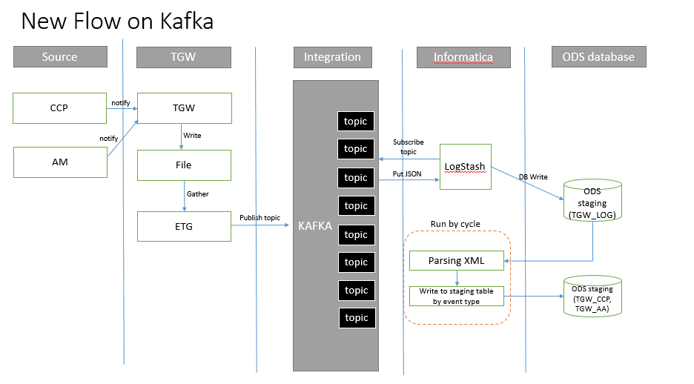
Example implementation

Slide 11
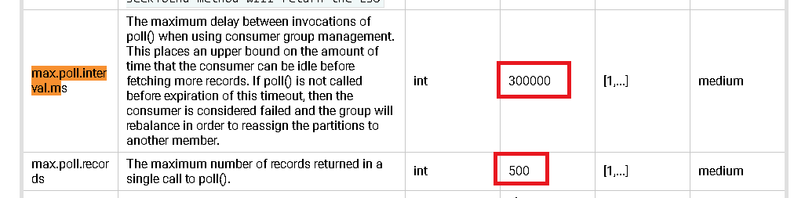
Configuration.
Need to consider:
Max.poll.interval.ms
Max.poll.record

